Slide 1
TSP With Hill Climbing, Simulated Annealing, And Threshold Accepting
Comparing local-search methods on a fixed 100-city traveling salesman instance
CSCI 165 project presentation
By: Ramraj Panesar and Hugo Rodriguez

Slide 2
Motivation And Problem Statement
Why This Domain Matters
Problem Addressed
The Traveling Salesman Problem is a classic optimization problem with real scheduling and routing relevance.
It appears in logistics, circuit design, delivery planning, and manufacturing.
It is computationally hard, so heuristic and local-search methods are often used in practice.
Find a short closed tour through 100 cities and return to the starting city.
Compare hill climbing, simulated annealing, and threshold accepting under a shared evaluation budget.
Determine which method finds the shortest tours most consistently on the same city instance.

Slide 3
Background And Approach
Background
Methods Used
A TSP solution is a permutation of city indices representing visit order.
The objective is to minimize total tour length, including the return to the first city.
Local search for TSP often relies on neighborhood operators such as swap and 2-opt reversal.
Hill Climbing: accepts only improving moves, with both plain and restart variants.
Simulated Annealing: sometimes accepts worse moves with probability based on temperature.
Threshold Accepting: deterministically accepts moves within a shrinking threshold.
All methods used the 2-opt neighborhood and a budget of 100,000 evaluations.

Slide 4
Experiment Setup
Fixed 100-city dataset reused across all algorithms for fairness.
30 repeated runs per algorithm with the same total evaluation budget.
Algorithms compared: HC_plain, HC_restart, SA_fast, SA_slow, and TA.
Metrics: mean tour cost, standard deviation, best and worst tour cost, and runtime.
The main comparison question was which method best balances exploration and solution quality.

Slide 5
Evaluation Results
Summary across 30 runs per algorithm
Algorithm | Mean Cost | Best Cost | Std Dev | Time (ms)
HC_plain | 835.02 | 785.24 | 19.49 | 1045.4
HC_restart | 830.07 | 807.59 | 14.06 | 1041.1
SA_fast | 938.89 | 898.91 | 25.81 | 159.2
SA_slow | 815.33 | 781.98 | 16.77 | 1129.9
TA | 854.21 | 824.14 | 22.78 | 1033.4

Slide 6
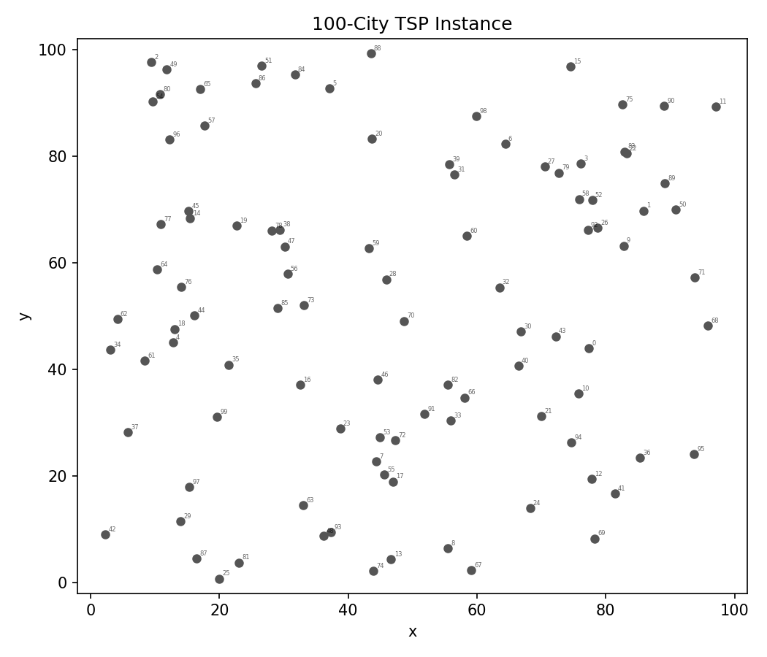
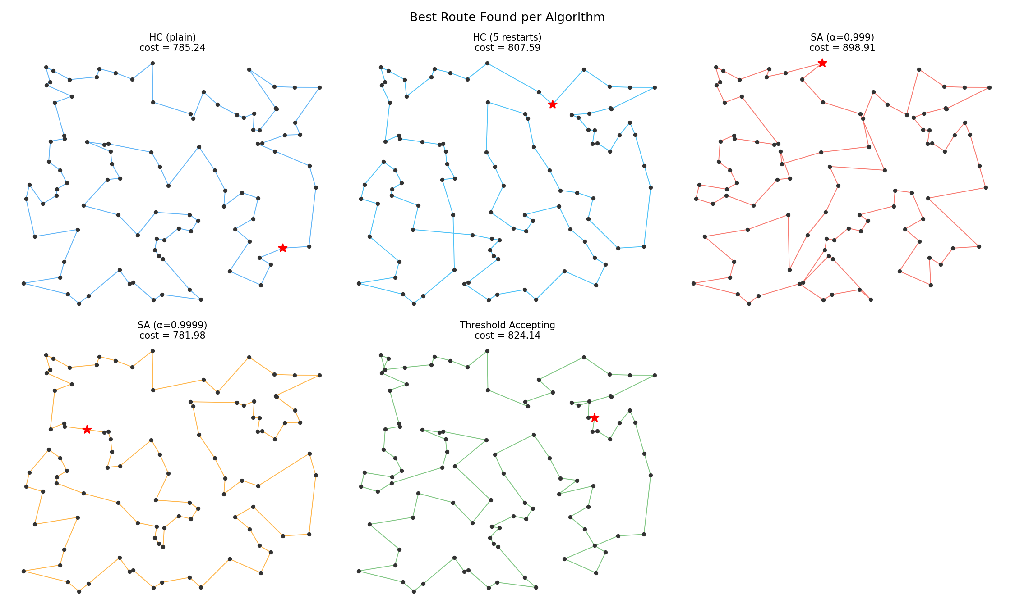
City Instance And Best Routes
All algorithms were tested on the same fixed 100-city dataset.
The route visualizations show how different search strategies shape the final tour.

Slide 7
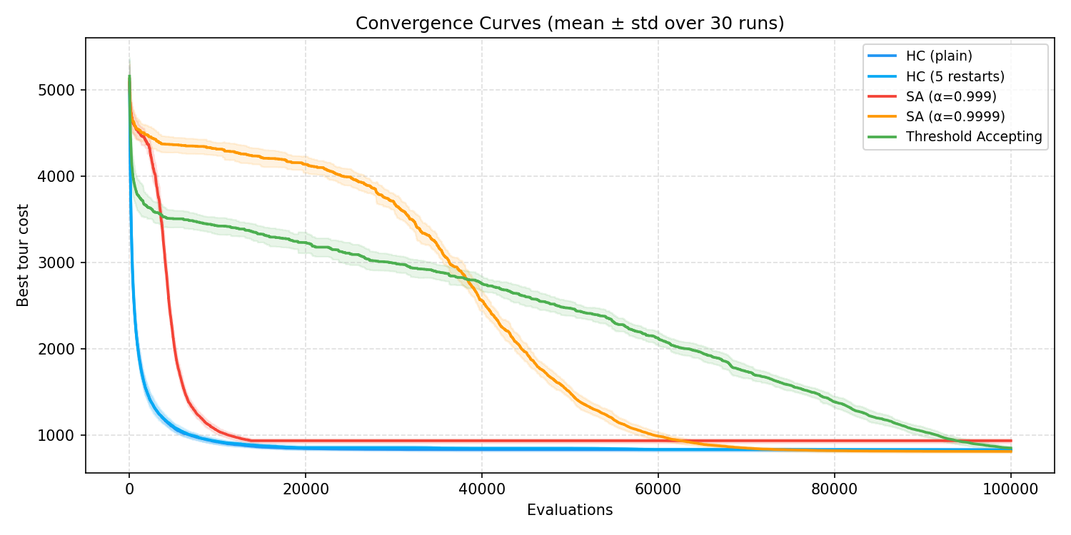
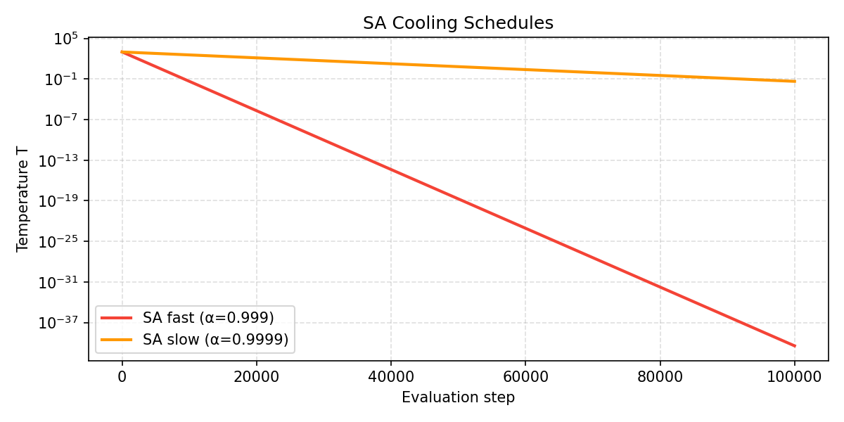
Convergence And Cooling Behavior
SA_slow converged to the strongest average solution quality over the run set.
Cooling rate mattered: slower annealing preserved exploration longer and improved solution quality.

Slide 8
Conclusions And Future Work
The best-performing method was SA_slow, with mean cost 815.33 and best cost 781.98 across the 30 runs.
Hill climbing was competitive and improved further with restarts, but it remained more vulnerable to local minima.
SA_fast cooled too quickly and performed worst on average, showing that exploration needs enough time to be useful.
Threshold accepting performed between hill climbing and the weaker annealing schedule, offering a deterministic compromise.
Future work: test larger city sets, tune restart counts and thresholds, and compare against genetic algorithms or ant-colony methods.

